Slide 1
FAKULTAS TEKNOLOGI INFORMASI
ANALISIS MEDIA SOSIAL DAN DIGITAL
[SI010 – 3 SKS – S2 ILMU KOMPUTER]

Slide 2
PENGANTAR MEDIA SOSIAL & DIGITAL
Pertemuan 01

Slide 3
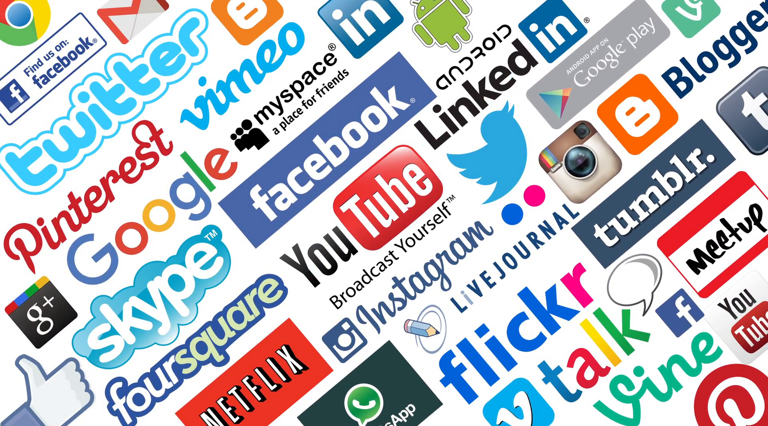
Social Media Analytics
Dr. Achmad Solichin, S.Kom., M.T.I.
Notes:
https://wowitloveithaveit.com/blogs/seo-software-tutorials/best-social-media-exchange-sites-list-for-2020

Slide 4
Notes:
https://wowitloveithaveit.com/blogs/seo-software-tutorials/best-social-media-exchange-sites-list-for-2020

Slide 5
What is Social Media?
Notes:
https://wowitloveithaveit.com/blogs/seo-software-tutorials/best-social-media-exchange-sites-list-for-2020

Slide 6
Social media are interactive technologies and digital channels that facilitate the creation and sharing of information, ideas, interests, and other forms of expression through virtual communities and networks
Notes:
1. Kietzmann, Jan H.; Kristopher Hermkens (2011). "Social media? Get serious! Understanding the functional building blocks of social media". Business Horizons (Submitted manuscript). 54 (3): 241–251. doi:10.1016/j.bushor.2011.01.005.
2. Obar, Jonathan A.; Wildman, Steve (2015). "Social media definition and the governance challenge: An introduction to the special issue". Telecommunications Policy. 39 (9): 745–e669. doi:10.2139/ssrn.2647377.

Slide 7
Core Characteristics of Social Media
Social Media is Many-to-many. Social media enables interaction among the users in a many-to-many fashion. This is unlike conventional technological media such as print, radio, telephone, and television.
Social Media is Participatory. Unlike conventional technologies, social media encourages participation and feedback from users. Social media users can participate in online discourse through blogging, comments, tagging, and sharing content.

Slide 8
Core Characteristics of Social Media
Social Media is User Owned. While social media platforms are provided by corporations (such as Google and Facebook), the content is generated, owned, and controlled by social media users. Without the user-generated contents and active involvement from the users, social media would be empty, boring online spaces.
Social Media is Conversational. It is not only the ease of conversation but also the many-to-many conversation abilities that make social media stand out from the traditional one-to-one or one-to-many medium of interaction. The many-to-many conversation characteristics of social media make it possible for the masses to communication and collaborate in real time.

Slide 9
Core Characteristics of Social Media
Social Media Enables Openness. Social media provides new opportunities to access data and information through Web 2.0 channels.
Social Media Enables Mass Collaboration. Social media channels allow masses to collaborate in a many-to-many fashion to achieve certain shared goals.

Slide 10
Core Characteristics of Social Media
Social Media is Relationship Oriented. Most social media tools allow users to easily establish and maintain social and professional relationships and ties. Some social media tools, such as Facebook, are solely focused on personal relationships, whereas others, such as Twitter, are focused on professional relationships.
Social Media is Free and Easy To Use. Being free and easy to use are two of the reasons that social media has proliferated in such a space

Slide 11
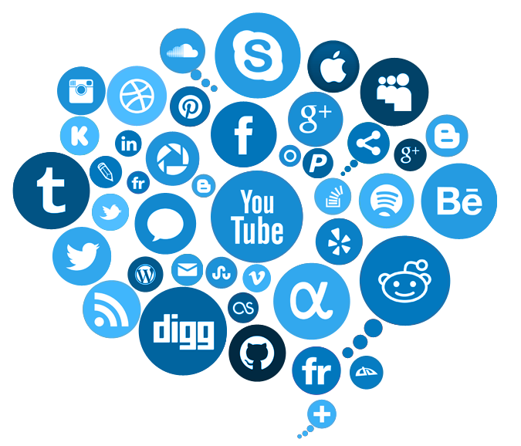
In one second…
9.924 Tweets sent
1.146 Instagram photos uploaded
2.061 Tumblr posts
6.663 Skype calls
145.054 GB of Internet traffic
100.637 Google searches
94.661 YouTube videos viewed
3.128.071 Emails sent (67% spam)
Sumber: https://www.internetlivestats.com

Slide 12
What is Social Media Analytics?
Social Media Analytics is the art and science of extracting valuable hidden insights from vast amounts of semistructured and unstructured social media data to enable informed and insightful decision making.

Slide 13
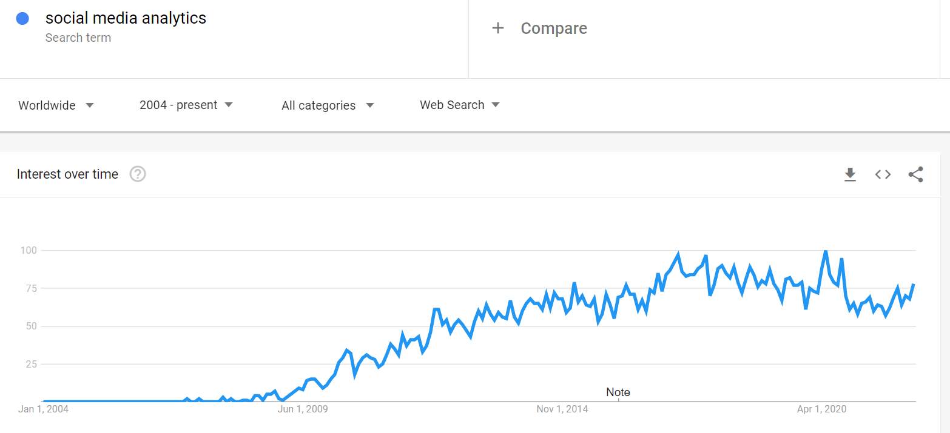
Trends of Social Media Analytics

Slide 14
Purposes of Social Media Analytics
What are customers using social media saying about our brand or a new product launch?
Which content posted over social media is resonating more with my customers?
How can I harness social media data (e.g., tweets and Facebook comments) to improve our product/services?
Is the social media conversation about our company, product, or service positive, negative, or neutral?
How can I leverage social media to promote brand awareness?
Who are our influential social media followers, fans, and friends?
Who are our influential social media nodes (e.g., people and organizations) and their position in the network?

Slide 15
Purposes of Social Media Analytics
Which social media platforms are driving the most traffic to our corporate website?
Where is the geographical location of our social media customers?
Which keywords and terms are trending over social media?
How active is social media in our business and how many people are connected with us?
Which websites are connected to my corporate website?
How are my competitors doing on social media?

Slide 16
Social Media vs Conventional Business Analytics
Social Media Analytics | Business Analytics
Semistructured and unstructured data | Structured data
Data is not analytical friendly | Data is analytical friendly
Real-time data | Mostly historical data
Public data | Private data
Stored in third-party databases | Stored in business-owned databases
Boundary-less data (i.e., Boundary within the Internet) | Bound within the business intranet
Data is high volume | Data is medium to high volume

Slide 17
Social Media vs Conventional Business Analytics
Social Media Analytics | Business Analytics
Highly diverse data | Uniform data
Data is widely shared over the Internet | Data is only shared within organizations
More sharing creates greater value/impact | Less sharing creates more value
No business control over data | Tightly controlled by business
Socialized data | Bureaucratic data
Data is informal in nature | Data is formal in nature

Slide 18
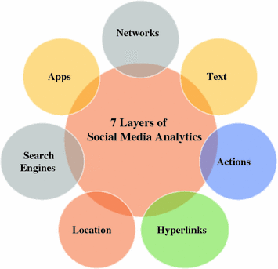
7 Layers of Social Media Analytics
Text
Networks
Actions
Hyperlinks
Mobile
Location
Search engines

Slide 19
Types of Social Media Analytics
Descriptive analytics is mostly focused on gathering and describing social media data in the form of reports, visualizations, and clustering to understand a business problem
Descriptive Analytics
Predictive Analytics
Predictive analytics involves analyzing large amounts of accumulated social media data to predict a future event.
Prescriptive analytics suggest the best action to take when handling a scenario. For example, if you have groups of social media users that display certain patterns of buying behavior, how can you optimize your offering to each group?
Prescriptive Analytics

Slide 20
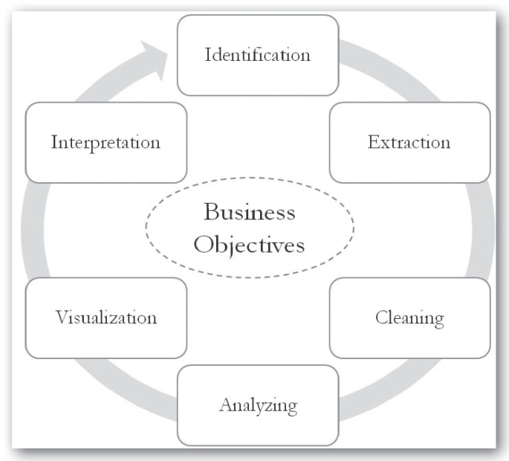
Social Media Analytics Life Cycle
Identification
Extraction
Cleaning
Analyzing
Vizualization
Intepretation

Slide 21
Challenges to Social Media Analytics
Volume and Velocity
Social media data is large in size and is swiftly generated. Capturing and analyzing millions of records that appear every second is a real challenge.
Diversity
Social media users and the content they generate are extremely diverse, multilingual, and vary across time and space. Due to the noisy and diverse nature of social media data, separating important content from noise is challenging and time consuming.
Unstructuredness
Unlike the data stored in the corporate databases, which are mostly numbers, social media data is highly unstructured and consists of text, graphics, actions, and relations

Slide 22
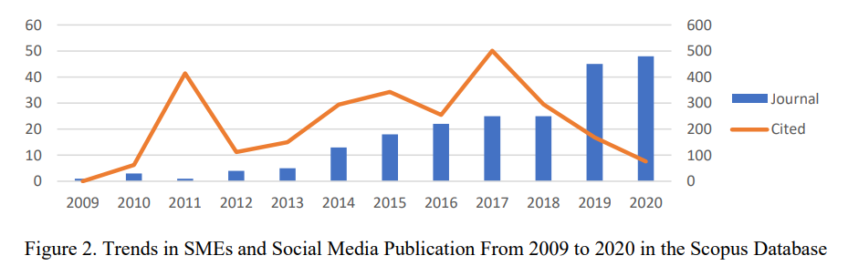
Social Media Analytics Research Trends
Notes:
Sumber: https://digitalcommons.unl.edu/libphilprac/5591/

Slide 23
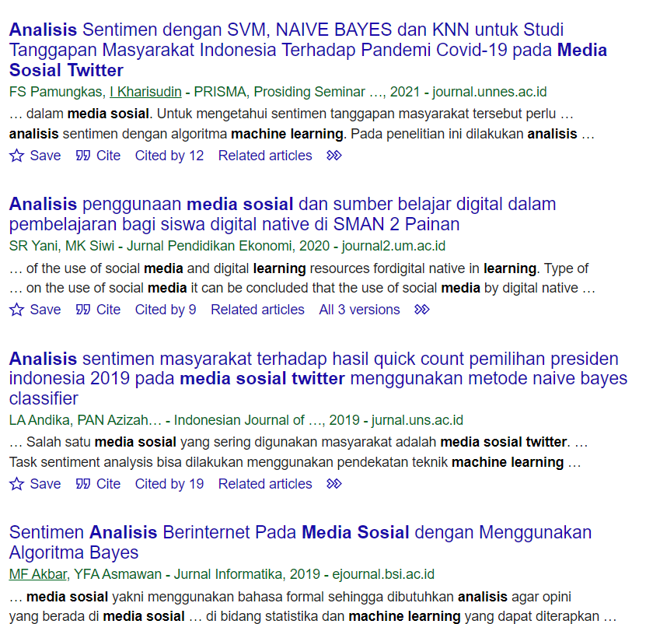
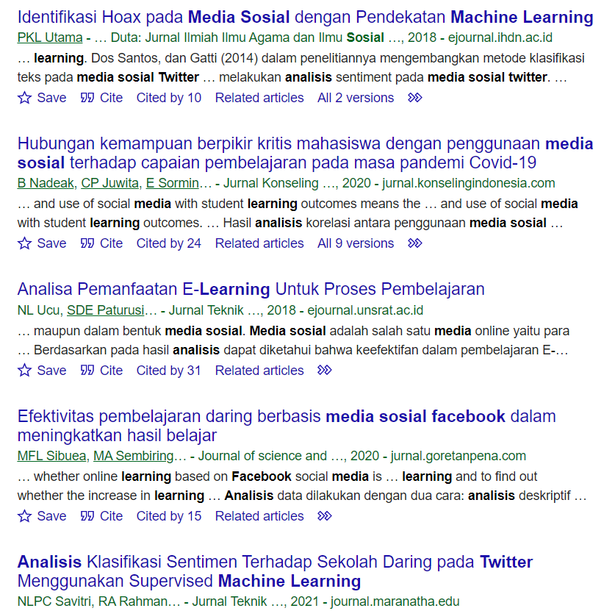
Social Media Analytics Research Trends
Notes:
Sumber: https://scholar.google.com/scholar?hl=en&as_sdt=0%2C5&as_ylo=2018&q=analisis+media+sosial+OR+twitter+OR+facebook+OR+instagram+OR+youtube+OR+machine+learning&btnG=

Slide 24
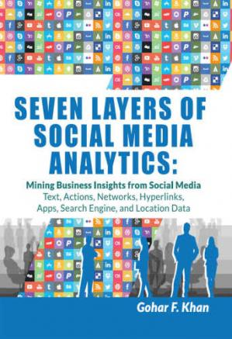
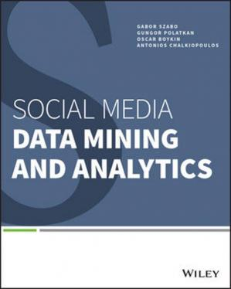


References / Books

Slide 25


Kesimpulan
SELESAI

